Slide 1
Handwriting Analysis
Using convolutional neural networks

Slide 2
AGENDA
Objective
MNIST
TrOCR
CNN
Result

Slide 3
objective
To develop a Convolutional Neural Network (CNN) capable of determining whether an image of handwriting was produced by a left- or right-handed person. The analysis will include Mazaal’s TrOCR for feature extraction and CNN to classify handwriting into left-handedness or right-handedness.

Slide 4
MNIST
preprocessing, augmentation, normalization

Slide 5
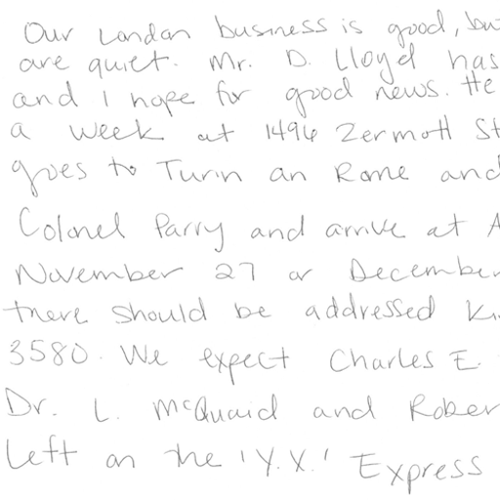
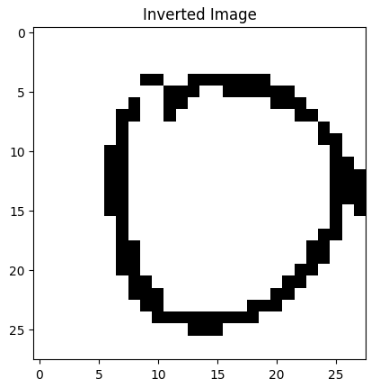
Preprocessing
Pulled all the lefties from the 4,261. Lefties make up 10% of the population. 47 ids, then extracted 47 right handed people for equal samples.
Png to jpeg
Resized 512x512 pixels
Convert to NumPy Array
Source Data 12,807 files
Source jpeg 4,261 images

Slide 6
augmentation
Q | B2B | SUPPLY CHAIN | ROI | E-COMMERCE
Q1 | 4.5 | 2.3 | 1.7 | 5.0
Q2 | 3.2 | 5.1 | 4.4 | 3.0
Q3 | 2.1 | 1.7 | 2.5 | 2.8
Q4 | 4.5 | 2.2 | 1.7 | 7.0
Otsu’s Thresholding
Invert Colors
OpenCV thresholding and blurring, basically advanced image processing

Slide 7
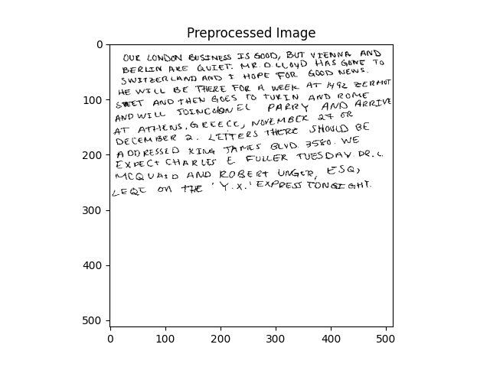
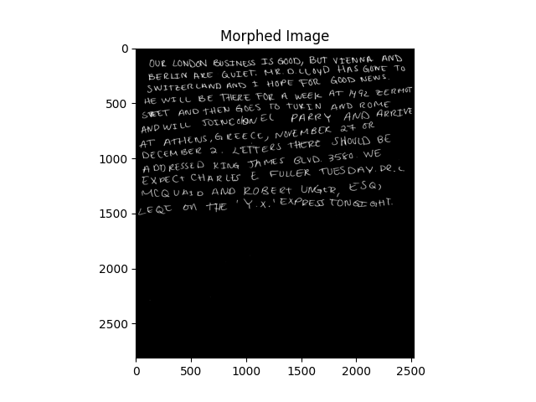
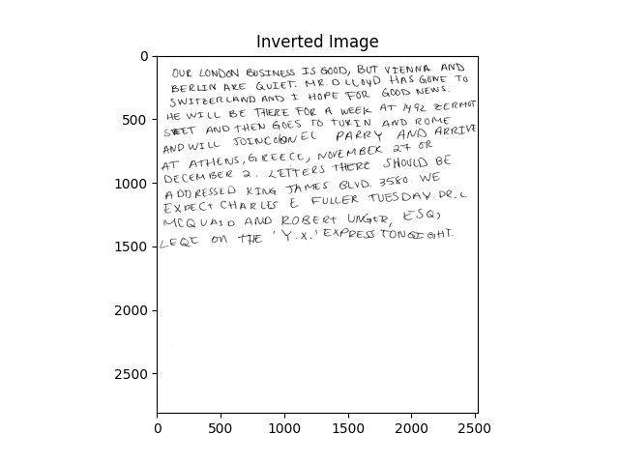
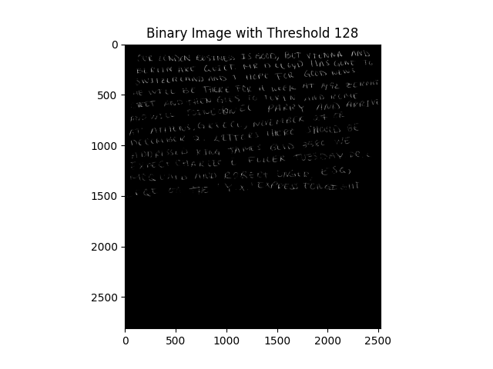

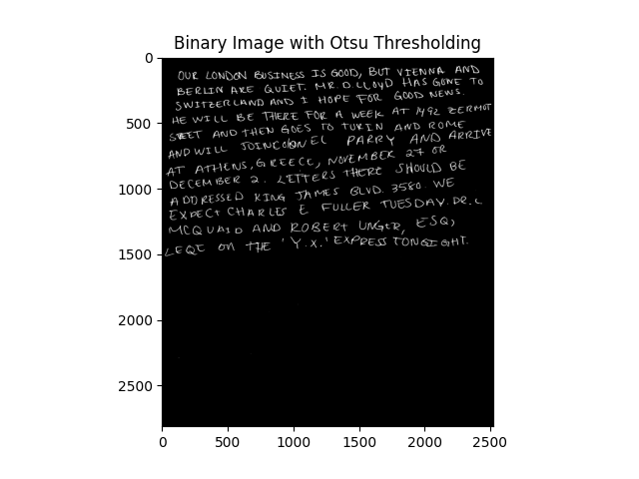
AUGMENTATION
Preprocessing
Data
TROCR
Result
Step 1
Step 3
Step 5
MNIST
CNN
Step 2
Step 4

Slide 8


Normalization
Scales pixel values to a [0,1] range for further processing. Files go from Source file to processed file.
“
”
data

Slide 9
Mazaal’s trocr
OpenCv again for edge detection and contour anlysis
Slant of handwriting
Stroke patterns
Curvature and Smoothness
Pressure distribution
Detects handwriting slant by finding edges and lines with OpenCV and calculates the average angle of detected lines.
Analyzes the direction of handwriting strokes by tracing contours and calculates angles between consecutive points of contours.
Calculates curvature for sets of three consecutive contour points using geometric formulas. Smoothness Is measured as the distance between points in a contour.
Measures handwriting pressure by applying Gaussian blur and thresholding on the grayscale image. Calculates the average sum of pixel intensities along rows.
Microssoft TrOCR is a pretrained model for handwritten text recognition.

Slide 10
Handedness
Trocr was for feature extraction. A column for handedness was added as a dictionary. 0 for left and 1 to right. When I extracted the lefties I had a list of 47, source and processing images had 47 images each. Left feature extraction made duplicates. The handedness column thus only added 0 to one set of ids, 47 of them.

Slide 11
Curvature Classification
This was the feature that had results already closest to 0 and 1. The curvature column was ideal for binary classification. Keeping the left and right samples separated, the mean calculation for left (0.698 + 0.721) / 2
and the mean classification for right was 0.699 + 0.720) / 2

Slide 12
Training a custom model
dataset
MNIST
DESIGN
trOCR
Train
Writing samples of both left-handedness and right-handedness
Make everything the same
Coordinate e-business applications
Feature extraction
Convoluted Neural Network for training a custom classification model

Slide 13
Model architecture
CNN
50 epochs
Develop winning strategies to keep ahead of the competition​
Capitalize on low-hanging fruit to identify a ballpark value​
Visualize customer directed convergence
Iterative approaches to corporate strategy
Establish a management framework from the inside

Slide 14
80/20 split ratio
Training set
Training Samples
Test samples
40 total, 20 left and 20 right
Whittled down from the handedness column and curvature classification.
Train_test_split is a scikit-learn function that splits dataset randomly based.
33 items
hi
7 samples
hi

Slide 15
Result
100% accuracy

Slide 16
Issues we ran into
Transcription
Time
Space and sizing, baseline alignment, letter formation
Why the left and right lists cloned the ids and had different results
Handedness not matching binary classification in training and test samples

Slide 17


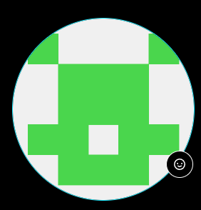




MEET OUR TEAM
Jordan graves
Jeff gary
Toni akande
Paige manguiat
​
​

Slide 18
THANK YOU ☺
Group 2
Jordan Graves, Jeff Gary, Toni Akande, Paige Manguiat
https://github.com/JGraves79/Handwriting_CNN.git
Vanderbilt University Data Analytics Bootcamp

